Slide 1
Building An RTOS: A Focus On Task Scheduling And Resouce Management For Time Sensitive Applications
SlideMake.com

Slide 2
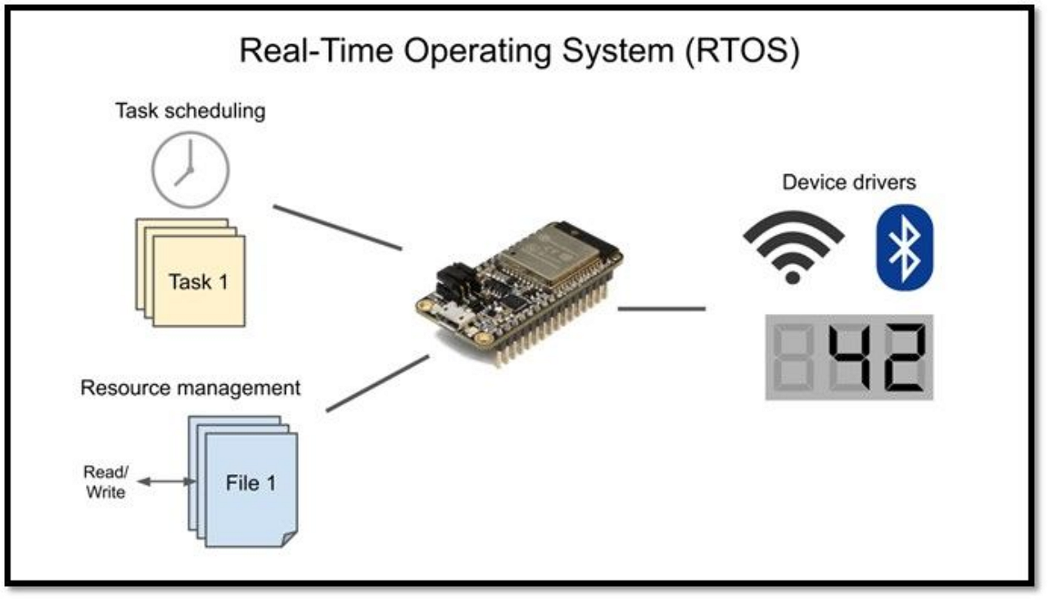
Introduction to RTOS
Real-Time Operating Systems (RTOS) are designed to manage hardware resources for time-sensitive applications.
They ensure that critical tasks meet their deadlines in a predictable manner.
Understanding task scheduling and resource management is essential for effective RTOS development.
Notes:
Image source: https://www.idiskhome.com

Slide 3

Importance of Task Scheduling
Task scheduling determines the order and timing of task execution in an RTOS.
It impacts system responsiveness and the ability to meet deadlines for critical tasks.
Proper scheduling algorithms are crucial for optimizing CPU utilization in time-sensitive applications.
Notes:
Image source: https://storage.googleapis.com

Slide 4
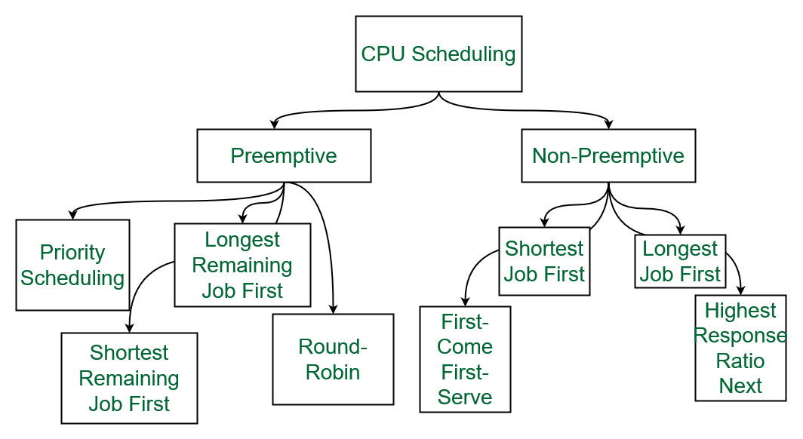
Types of Scheduling Algorithms
Common scheduling algorithms include Rate Monotonic Scheduling (RMS) and Earliest Deadline First (EDF).
RMS assigns priorities based on task periodicity, making it suitable for fixed-priority systems.
EDF dynamically prioritizes tasks based on their deadlines, offering better performance in variable workloads.
Notes:
Image source: https://media.geeksforgeeks.org

Slide 5

Preemptive vs Non-Preemptive Scheduling
Preemptive scheduling allows higher-priority tasks to interrupt lower-priority tasks.
This approach enhances responsiveness but introduces complexity in resource management.
Non-preemptive scheduling ensures that once a task starts, it runs to completion, simplifying resource management.
Notes:
Image source: https://i.ytimg.com

Slide 6

Resource Management Challenges
Resource management involves allocating system resources to various tasks while avoiding conflicts.
Common challenges include deadlocks, priority inversion, and resource starvation.
Effective strategies are needed to ensure that all tasks can access the resources they require without delays.
Notes:
Image source: https://www.aeologic.com

Slide 7
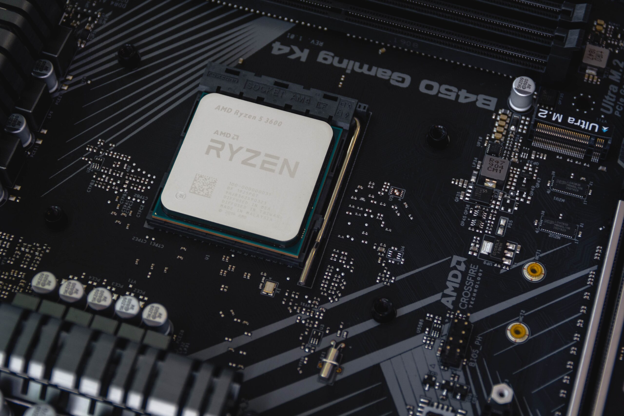
Mutexes and Semaphores
Mutexes are used to provide exclusive access to resources among competing tasks.
Semaphores are signaling mechanisms that help synchronize task execution based on resource availability.
Proper use of these tools is vital to prevent deadlocks and ensure smooth task operation.
Notes:
Image source: https://tbwr.blog

Slide 8
Memory Management in RTOS
Memory management is critical for maintaining system stability in real-time applications.
Dynamic memory allocation must be handled carefully to avoid fragmentation and unpredictability.
Static memory allocation is often preferred for critical tasks to ensure deterministic behavior.
Notes:
Image source: https://miro.medium.com

Slide 9
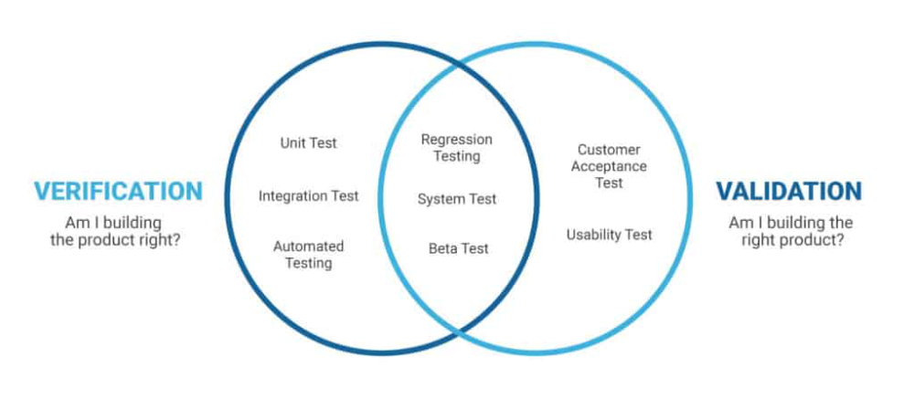
Testing and Validation
Rigorous testing is essential to ensure that the RTOS meets its timing and resource management requirements.
Validation techniques include stress testing, simulation, and formal verification methods.
Ensuring reliability in time-sensitive applications is key to maintaining system integrity.
Notes:
Image source: https://i.pinimg.com

Slide 10
Case Studies of RTOS in Use
Successful RTOS implementations can be seen in automotive, aerospace, and industrial automation.
Each industry has unique requirements for task scheduling and resource management.
Analyzing these case studies can provide insights into best practices and common pitfalls.
Notes:
Image source: https://www.researchgate.net

Slide 11

Future Trends in RTOS Development
Emerging technologies such as IoT and edge computing are driving the evolution of RTOS.
Future developments will focus on enhancing scalability, security, and adaptability in real-time systems.
Staying ahead of these trends is essential for building efficient RTOS for next-generation applications.
Notes:
Image source: https://datasciencedojo.com

